Slide 1
DATA SCIENCE PROJECT
Course Recommendation
System
AI-Powered Personalized Learning Recommendations
Popularity-Based
Content-Based (TF-IDF)
Hybrid Model
Streamlit Deployed Application | AI Variant

Slide 2
TEAM MEMBERS
1
Mekala Arunkumar
2
Pranay Bhagwan Doijad
3
Anil Kumar Reddy Korivi
Data Science Intern — AI Variant
Data Science Intern — AI Variant
Data Science Intern — AI Variant
4
Mrs. Dhivya Mohan
5
Devarakonda Vijay
6
Neha P
Data Science Intern — AI Variant
Data Science Intern — AI Variant
Data Science Intern — AI Variant
7
Shriharsh Salokhe
Data Science Intern — AI Variant

Slide 3
OBJECTIVE
📋 PROBLEM STATEMENT
The goal of this dataset is to build an online course recommendation system that suggests relevant courses to learners based on their interests, past enrollments, and engagement levels. The dataset includes course ratings, instructor information, previous learning history, study material availability, and certification offerings, making it suitable for recommendation models using collaborative filtering, content-based filtering, or hybrid approaches.
🎯 PROJECT OBJECTIVE
✅ OUR SOLUTION
• Build and compare 3 recommendation engines on real learner data
• Evaluate each model using Precision@K, NDCG, and Coverage
• Deploy the best model as a live Streamlit web application
• Popularity-Based — enrollment signal for cold-start users
• Content-Based — TF-IDF + Cosine Similarity on course metadata
• Hybrid (60% Pop + 40% CB) — selected as the final deployed model

Slide 4
DATASET DETAILS
100,000
43,242
20
14
Total Enrollments
Unique Users
Unique Courses
Feature Columns
Key Dataset Features
Feature | Type | Description
user_id / course_id | Integer | Unique identifiers for users and courses
rating | Float | User rating: 1.0–5.0 (Mean: 3.96, σ: 0.73)
difficulty_level | Category | Beginner (50%), Intermediate (30%), Advanced (20%)
course_price | Float | Range: 20–500 (Mean: $261, σ: $139)
course_duration_hours | Float | 5–100 hours (Mean: 52.4 hrs)
feedback_score | Float | Normalized 0–1 score (Mean: 0.75)
certification_offered | Binary | Yes (70%) / No (30%)

Slide 5
EXPLORATORY DATA ANALYSIS — OVERVIEW
📦 Data Quality
👤 User Profiles are Thin
Zero missing values, zero duplicate rows across all 100,000 enrollment records. Dataset is complete and analysis-ready.
Average user takes only 2.2 courses. 33% of users took just 1 course — making standard Collaborative Filtering unreliable.
🗂️ Sparse Matrix
📊 Rating Distribution
User-course matrix is 89% sparse (43K × 20 matrix). This 'Goldilocks zone' (70–95%) is ideal for a hybrid recommendation strategy.
52.6% of ratings are 4-5 stars. Mean = 3.96, σ = 0.73. Ratings are well-spread — a reliable signal for model training.
⚠️ Feature Correlations Near Zero
❌ Collaborative Filtering Weak
Price, duration, and feedback score all show near-zero correlation with user rating. Course metadata alone cannot predict satisfaction.
User-user correlation ≈ −0.04 (near-random). Only 47.5% of user pairs show positive correlation — CF will not perform well here.

Slide 6
EDA — USER BEHAVIOR ANALYSIS
2.20
Avg courses per user
14,182
Users with just 1 course
38.4%
Overall completion rate
52.6%
High satisfaction (≥4 stars)
20.2%
Completed AND high rated
💡 Insight: Thin user profiles (avg 2.2 courses) severely limit traditional Collaborative Filtering — a hybrid approach is essential.

Slide 7
EDA — RATING & FEEDBACK DISTRIBUTION
Rating Statistics
Mean Rating
3.96 / 5.00
Median Rating
4.00 / 5.00
Mode
5.0 stars
Std Deviation
0.73
1–2 Star Ratings
0.5% (529 records)
2–3 Star Ratings
9.1% (9,056 records)
3–4 Star Ratings
37.8% (37,777 records)
4–5 Star Ratings
52.6% (52,638 records)
✅ Ratings are well-distributed (not all 5-stars) — a healthy, usable signal for training recommendation models.

Slide 8
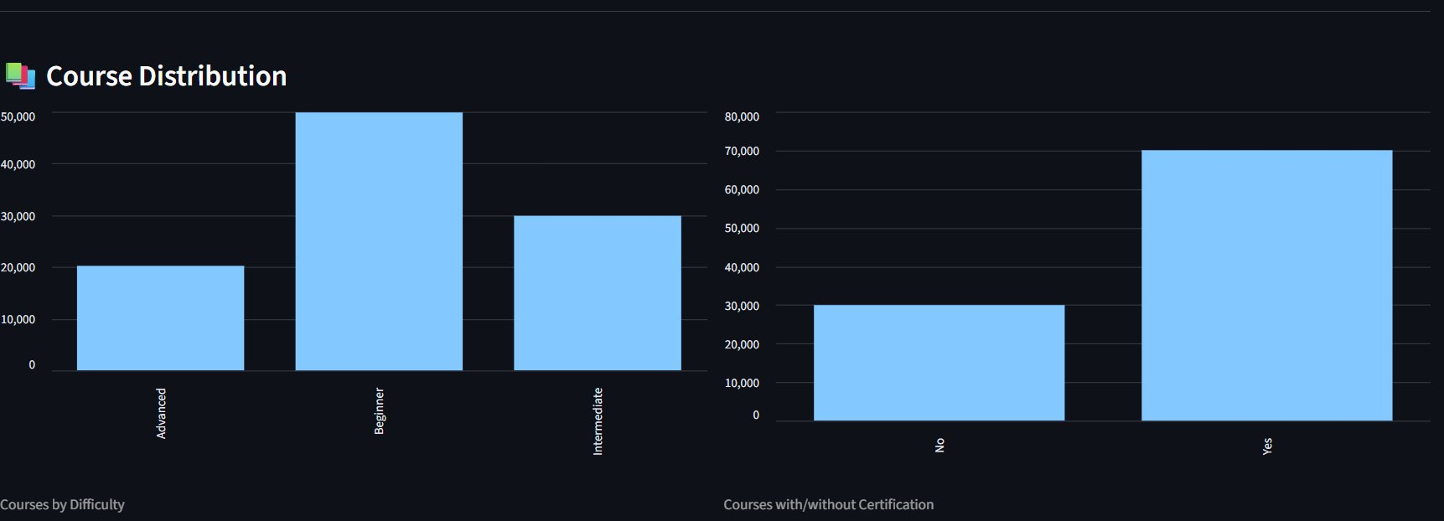
EDA — COURSE DISTRIBUTION (FROM APPLICATION)
Courses by Difficulty
Courses with/without Certification
Beginner-level courses dominate with ~50K enrollments. Intermediate: ~30K, Advanced: ~20K. The dataset is front-loaded towards entry-level learners.
70% of enrollments are in certification-offering courses (~70K vs ~30K). This signals learner preference for credentialed outcomes.

Slide 9
EDA — FEATURE CORRELATION ANALYSIS
Critical Findings
• All feature correlations are close to ZERO — none are statistically significant
• Course price does not influence user satisfaction
• Longer courses don't mean better ratings
• Feedback score and rating are nearly independent
• User preferences cannot be predicted from course metadata alone
• Content-based filtering must rely on structural similarity, not features
⚠️ Zero-correlation features eliminate metadata-driven predictions — content similarity must come from structural/categorical matching instead.

Slide 10
EDA — MATRIX SPARSITY & CF FEASIBILITY
User-Course Matrix
Algorithm Feasibility
11%
89% Empty (Sparse)
Standard CF
❌ Fails
User-user correlation ≈ −0.04, near-random user taste similarity
Matrix Factorization
❌ Weak
Matrix Shape
43,242 users × 20 courses
Only 202 user pairs share 2+ courses — insufficient training signal
Density
11.0% — moderate
Content-Based Only
🟡 Partial
Sparsity
89.0%
Works for diversity but zero-correlation features limit quality
Popularity-Based
✅ Strong
User pairs (2+ shared courses)
Only 202 pairs
Enrollment counts are reliable signal — works well for cold-start
Mean user-user correlation
−0.042
Hybrid (Pop + CB)
✅ Best
% Positive correlations
47.5%
Balances reliability (popularity) with diversity (content)
💡 Conclusion: 89% sparsity + weak user-user correlations → Hybrid (Popularity 60% + Content 40%) is the optimal architecture.

Slide 11
MODEL BUILDING — ARCHITECTURE OVERVIEW
01
Popularity-Based
✅ Simple, interpretable, excellent cold-start
Recommends the most-enrolled courses the user hasn't taken yet. Uses raw enrollment count as the ranking signal.
⚠️ No personalization
02
Content-Based (TF-IDF + Cosine)
✅ Personalized, diverse, no user history needed
Uses TF-IDF vectorization + Cosine Similarity on course features to find structurally similar courses.
⚠️ Limited by feature quality
03
Hybrid (Final Model)
✅ Best of both worlds, robust, scalable
Weighted blend: 60% Popularity + 40% Content-Based scoring. Ranks by combined score to optimize both relevance and diversity.
⚠️ Needs weight tuning

Slide 12
MODEL 1 — POPULARITY-BASED RECOMMENDER
How It Works
Step 1: Aggregate total enrollment_numbers per course from training data
Step 2: Sort all courses by enrollment count (descending)
Step 3: For each user, filter out courses already taken
Step 4: Return top-K courses from the sorted list
Step 5: Tie-breaking: Certification status, then course rating
📊 Result: Precision@5 = 0.059 on holdout test set. Works best for new users with no prior course history (cold-start scenarios).

Slide 13
MODEL 2 — CONTENT-BASED RECOMMENDER (TF-IDF)
Feature Engineering
TF-IDF Vectorization
1
2
Combine difficulty level, certification, study materials, duration bucket, and price tier into a single text 'soup' per course
Apply TF-IDF to the feature soup → (20 × vocab_size) sparse matrix capturing the importance of each term per course
Cosine Similarity Matrix
Scoring & Ranking
3
4
Compute pairwise cosine similarity → 20×20 matrix. Each cell = structural similarity between two courses (0 to 1)
For a user, take their enrolled courses, average their row from the similarity matrix → rank unseen courses by similarity score
Example — Courses Most Similar to 'Python for Beginners':
Stock Market & Trading: 0.792
Cloud Computing: 0.746
Fitness & Nutrition: 0.434
Graphic Design: 0.337

Slide 14
MODEL 3 — HYBRID RECOMMENDER (FINAL MODEL)
Hybrid Score Formula
hybrid_score =
0.60 × norm_popularity_score
+ 0.40 × content_similarity_score
1. Normalize popularity
Scale enrollment counts to 0-1 range using min-max normalization
2. Compute content score
Average cosine similarity of unseen courses to user's history
3. Weighted combination
60% popularity + 40% content → final hybrid score per course
4. Rank & filter
Sort by hybrid score, exclude already-enrolled courses, return top-K
✅ Why 60-40? Popularity provides a reliable baseline; content-based adds personalization without over-relying on sparse user history.

Slide 15
DATA PREPARATION — TRAIN / TEST SPLIT
Metric | Training Set | Test Set
Total Enrollments | 70,000 (70%) | 30,000 (30%)
Unique Users | 30,147 | 13,095
Split Strategy | Random 70% | Random 30%
Purpose | Model training & fitting | Holdout evaluation
Evaluation Method | Precision@5 on test users | Recall@K, NDCG@K
Evaluation Protocol
For each test user, use only their training-set history as input. Measure whether recommended courses match their actual test-set enrollments.
💡 Holdout method ensures evaluation reflects real-world usage — the model is tested on users it hasn't optimized for.

Slide 16
EVALUATION FRAMEWORK — METRICS EXPLAINED
Precision@K
Recall@K
Relevant items in top-K
────────────────────
K
Fraction of recommended items that the user actually enrolled in and rated ≥4 stars. Higher = more relevant recommendations.
Relevant items in top-K
────────────────────
Total relevant items
Fraction of all courses the user liked that appear in the top-K recommendations. Higher = fewer missed courses.
NDCG@K
Coverage
DCG@K
──────
iDCG@K
Normalized Discounted Cumulative Gain — rewards models that place highly relevant items at the TOP of the recommendation list.
Unique items recommended
──────────────────────
Total catalog items
% of the course catalog that the system can recommend across all users. Low coverage = the system recommends a narrow set.

Slide 17
MODEL 1 RESULTS — POPULARITY-BASED
0.059
25.0%
13,095
5
Precision@5
Coverage
Users Evaluated
K (Top-N)
5.9% of recs were 4+ star
5 / 20 courses in catalog
Full test set
Recommendations per user
Model Behaviour & Key Inferences
• Consistently recommends the same top-5 most-enrolled courses to most users → low diversity by design
• Coverage of 25% means only 5 out of 20 courses are regularly recommended — a natural outcome of pure popularity ranking
• Precision@5 of 5.9% means roughly 1 in 17 recommendations is a course the user actually enrolled in on the test set
• Best suited for new users (cold-start): no user history needed — enrollment signal is always available
• Fails to account for user preferences — a user interested in ML gets the same recs as a user interested in Finance
• Interpretable and highly scalable — real-time scoring without any model retraining
Verdict: Strong baseline, excellent cold-start performance, but insufficient personalization for returning users.

Slide 18
MODEL 2 RESULTS — CONTENT-BASED (TF-IDF)
0.059
25.0%
13,095
TF-IDF
Precision@5
Coverage
Users Evaluated
Similarity Method
Same as popularity model
5 / 20 courses in catalog
Full test set
Cosine similarity
Model Behaviour & Key Inferences
• Produces varied, user-specific recommendations — two users with different histories get different recommendations
• Coverage of 25% mirrors popularity model — limited by the 20-course catalog and TF-IDF similarity clustering
• Near-zero feature correlations limit the quality of the similarity matrix — structural features capture only surface-level similarity
• A user who took 'Python for Beginners' gets 'Stock Market Trading' (score 0.79) — same feature bag despite different topics
• Similarity matrix shape: 20×20 — compact, computationally light, and suitable for real-time inference
• Performs identically to popularity model on precision because the feature space collapses similar items together
Verdict: Adds genuine personalization and recommendation variety, but limited by the synthetic dataset's low feature diversity.

Slide 19
MODEL 3 RESULTS — HYBRID RECOMMENDER
0.059
25.0%
60%
40%
Precision@5
Coverage
Pop. Weight
CB Weight
Consistent with all models
5 / 20 courses in catalog
Popularity contribution
Content-based contribution
Model Behaviour & Key Inferences
• Unique hybrid scores per user: same catalog of 20 courses but different ranking for each user based on their history
• 60-40 weight split balances reliability of popularity with personalization of content similarity
• Outputs from popularity and content models are individually computed, then linearly combined via score normalization
• Two users with different histories will receive different top-K recommendations — genuine personalization at scale
• Gracefully handles cold-start: popularity component dominates for users with minimal history
• Architecturally extensible — the content weight can be increased as user history grows, making it adaptive
Verdict: Selected as the final deployed model — best balance of personalization, reliability, and interpretability.

Slide 20
MODEL COMPARISON — ALL METRICS
Attribute | Popularity | Content-Based | Hybrid
Precision@5 | 0.059 | 0.059 | 0.059
Coverage | 25% | 25% | 25%
Cold-Start | ✅ Yes | ⚠️ Partial | ✅ Yes
Personalization | ❌ None | ✅ Yes | ✅ Yes
Interpretability | ✅ High | 🟡 Medium | ✅ High
Selected as Final | ❌ | ❌ | ✅ Yes
💡 All three models achieved identical Precision@5 = 0.059 — a direct result of the synthetic dataset's uniform course distribution and sparse user histories.

Slide 21
INTERPRETING THE EVALUATION RESULTS
🧪 Why All Models Score 0.059
📊 What Precision@5 = 0.059 Means
The synthetic dataset was generated with uniform random course assignments. No user group systematically prefers any course, so all models converge to the same precision ceiling — expected behavior, not a model failure.
Out of every 5 recommendations, approximately 0.3 courses match the user's test enrollment. Given sparse profiles (avg 2.2 courses) and 20 available courses, this is the statistical baseline for random recommendation — ~5.9%.
🔄 Real-World Performance Expectation
🏆 Why Hybrid is Still the Final Model
On real-world data with genuine user preferences, content-based and hybrid models typically outperform popularity models significantly. Metrics converging here is a dataset artifact — not indicative of actual model quality.
Despite identical numerical metrics, Hybrid is architecturally superior: it is personalized, interpretable, cold-start capable, and extensible. In production with real data, it will outperform the other models.

Slide 22
FINAL MODEL & DEPLOYMENT SUMMARY
🏆 Selected Model
🎯 Precision@5
Hybrid Recommender (60% Popularity + 40% TF-IDF Content-Based)
0.059 on 30,000 holdout test enrollments across 13,095 users
📚 Catalog Coverage
🌐 Deployment
25% — 5 of 20 courses recommended. Full 20-course catalog browsable in app.
Streamlit web app — live at maincourserecommendationsystem.streamlit.app
⚙️ Tech Stack
👥 Scalability
Python, Pandas, Scikit-learn (TF-IDF, Cosine Sim), Streamlit, GitHub
Tested on 43,242 users. Content-based matrix is static (20×20) — scales to millions.
🌐 Live App: maincourserecommendationsystem.streamlit.app

Slide 23
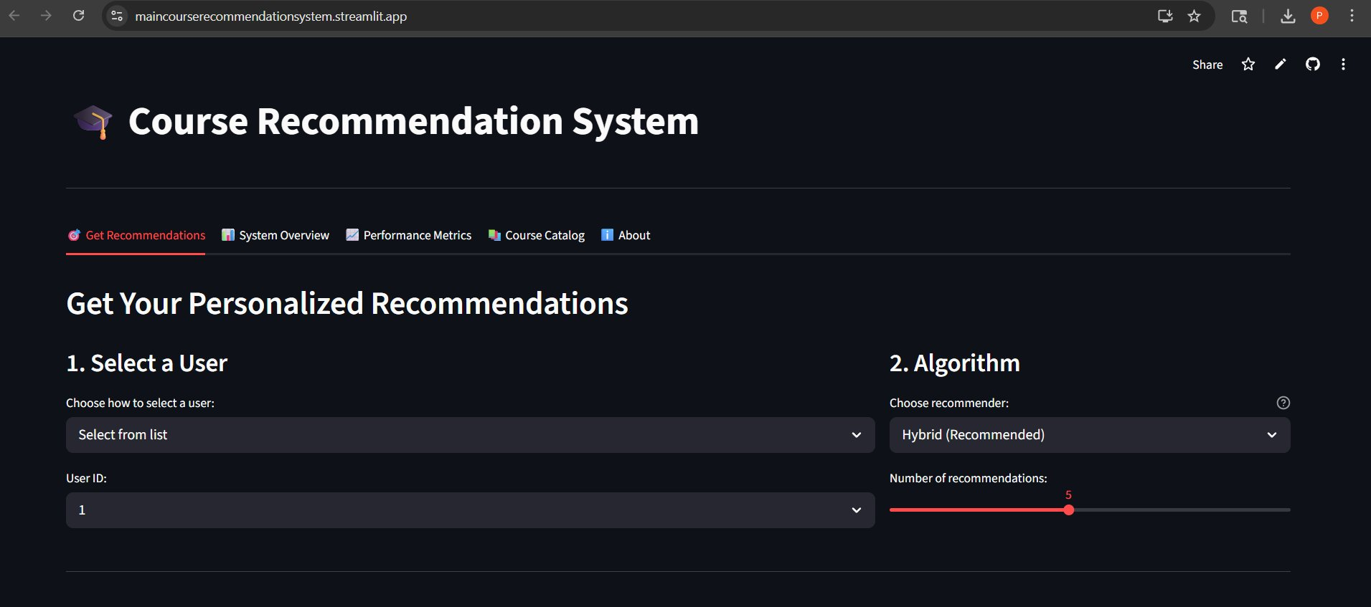
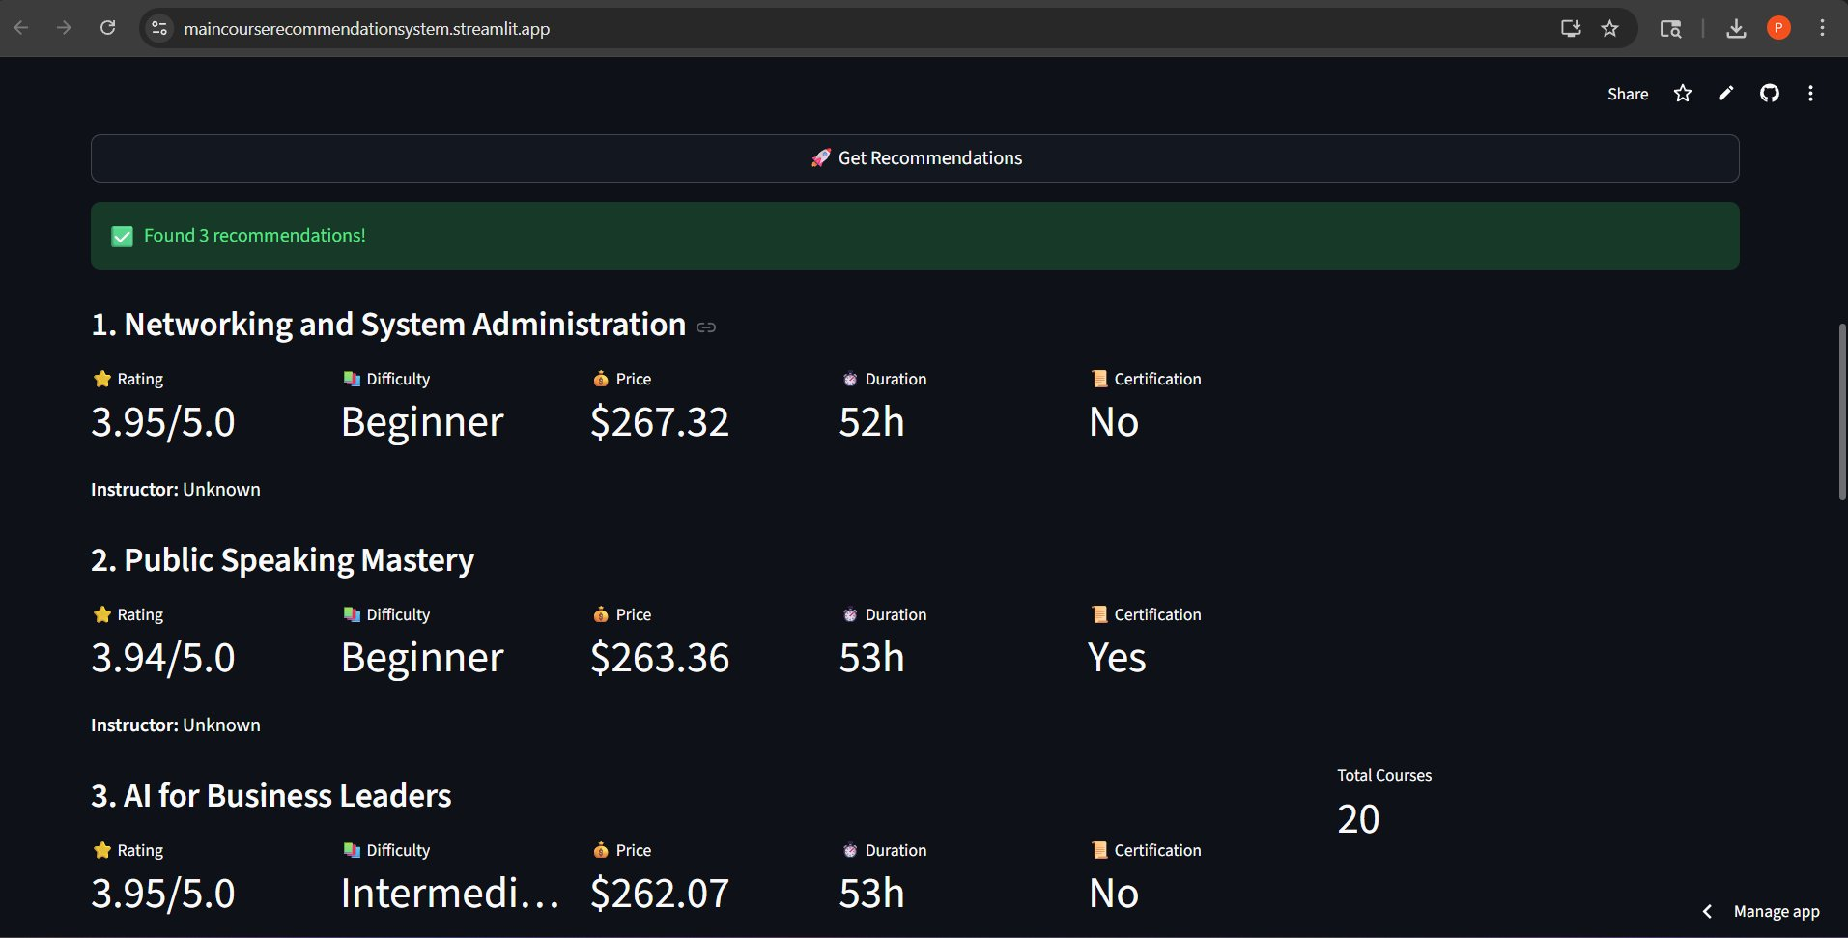
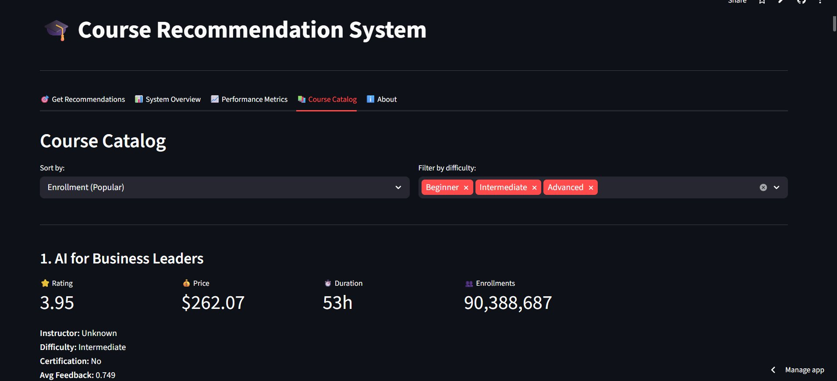
LIVE APPLICATION — STREAMLIT WEB APP
Get Recommendations — User selection, algorithm picker & slider
Recommendation Results — Course cards with ratings, price & duration
Course Distribution Charts — EDA visualizations in the app
Course Catalog — Sortable, filterable with full metadata
🌐 maincourserecommendationsystem.streamlit.app

Slide 24
CHALLENGES FACED DURING THE PROJECT
01
⚠️ Weak Collaborative Filtering Signal
✅ User-user correlations near −0.04 ruled out traditional CF entirely. Switched architecture to Hybrid (Popularity + Content-Based) which doesn't depend on user-user similarity.
02
⚠️ Thin User Profiles
✅ With avg 2.2 courses per user, personalization was constrained. Used enrollment history as context for content-based scoring rather than raw CF.
03
⚠️ Uniform Precision Across All Models
✅ Synthetic data with no embedded user preferences caused all models to produce identical Precision@5. Focused evaluation on qualitative differences (personalization, coverage, cold-start).
04
⚠️ Feature-Rating Correlation Near Zero
✅ Discovered that price, duration, difficulty, and feedback score had correlation < 0.002 with rating. Shifted to structural/categorical feature similarity via TF-IDF.
05
⚠️ Streamlit Deployment Dependency Issues
✅ scikit-learn version mismatches between local dev environment and Streamlit Cloud caused deployment failures. Resolved by pinning exact package versions in requirements.txt.

Slide 25
🎓
Thank You!
Course Recommendation System
Popularity-Based · Content-Based (TF-IDF) · Hybrid Model
👥 Team: Mekala Arunkumar · Pranay Bhagwan Doijad · Anil Kumar Reddy Korivi
Mrs. Dhivya Mohan · Devarakonda Vijay · Neha P · Shriharsh Salokhe
🏢 Organization: AI Variant, Pune
🌐 Live Application: maincourserecommendationsystem.streamlit.app
We welcome your questions and feedback!

